Slide 1
Introducing the paper : Esrgan: Enhanced super-resolution generative adversarial networks
Paper : Wang, Xintao, Ke Yu, Shixiang Wu, Jinjin Gu, Yihao Liu, Chao Dong, Yu Qiao, and Chen Change Loy. "Esrgan: Enhanced super-resolution generative adversarial networks." In Proceedings of the European conference on computer vision (ECCV) workshops, pp. 0-0. 2018.
Presented by: Joshi Jay Vijaybhai
(200485155)

Slide 2
Why European Conference on Computer Vision (ECCV)
it is considered an important conference in computer vision, with an ‘A’ rating from the Australian Ranking of ICT Conferences and an ‘A1’ rating from the Brazilian ministry of education.
it has research ranking of 4 and impact score of 33.20.

Slide 3
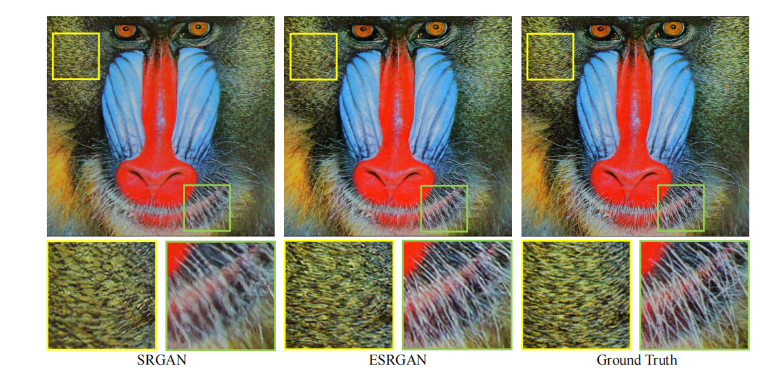
Introduction of the Paper
The paper presents ESRGAN (Enhanced Super-Resolution Generative Adversarial Network), an advanced model for image super-resolution. ESRGAN offers substantial improvements in perceptual quality over previous super-resolution methods.

Slide 4
The key contributions and findings of the paper can be summarized as follows:
Training Details: ESRGAN employs a scaling factor of 4x for low-resolution (LR) to high-resolution (HR) image transformation. Training begins with a PSNR-oriented model using L1 loss and is later fine-tuned with a generator loss function. Larger patch sizes are used for deeper networks, which capture more semantic information.
Data: The paper leverages diverse datasets, including DIV2K, Flickr2K, and OutdoorSceneTraining, to enrich the training dataset. Using datasets with rich textures helps the generator produce more natural results.
Qualitative Results: ESRGAN is compared to state-of-the-art PSNR-oriented and perceptual-driven methods, showing superior results in terms of sharpness, detail, and natural textures. ESRGAN excels in various scenarios, including the generation of detailed structures and the elimination of unpleasant artifacts.

Slide 5
The key contributions and findings of the paper can be summarized as follows:
Network Interpolation: Network interpolation is introduced to balance perceptual quality and fidelity, reducing artifacts while preserving textures. This approach provides smoother control over the trade-off.
The PIRM-SR Challenge(Perceptual Image Restoration and Manipulation - Super Resolution): ESRGAN participated in the PIRM-SR Challenge and secured the first place in terms of the perceptuality. Modifications included the use of the Pristine dataset, and post-processing.

Slide 6
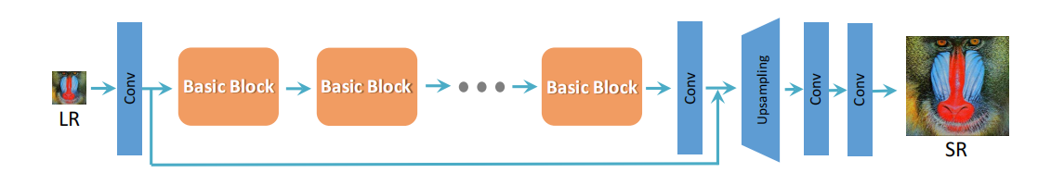
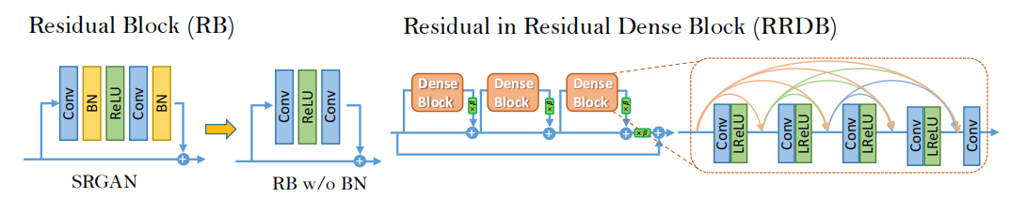
Proposed Method
We employ the basic architecture of SRResNet [1], where most computa- tion is done in the LR feature space.
Network Architecture
Removing BN layers has proven to increase performance and reduce com- putational complexity

Slide 7
Conclusion
In conclusion, ESRGAN represents a substantial advancement in super-resolution techniques, achieving state-of-the-art results in terms of perceptual quality, sharpness, and natural textures. The methodology involves a novel architecture, effective training techniques, and enhanced perceptual loss, making it a prominent contribution to the field of image super-resolution.

Slide 8
Thank You

